Slide 1
US National Hot Dog Month
Presented by Group 3:
Deep Learning Dogs

Slide 2
Table of contents
01
03
Problem Statement
Winning & Additional Models
02
04
Pre-Processing
Streamlit App

Slide 3
Problem Statement
July is National Hot Dog Month! In preparation, we have been hired by Nathan’s Famous to design an app that customers can use to add some flair to their BBQ. This app is intended to take any given photo and determine if the photo is of a hot dog or not. Fun for all ages and guaranteed entertainment!

Slide 4
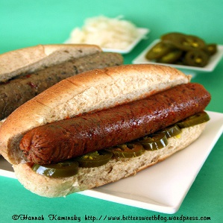
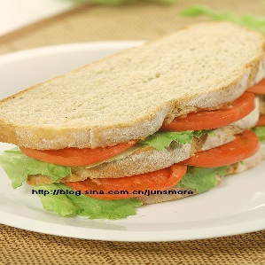
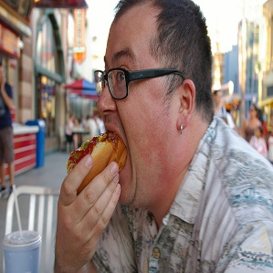
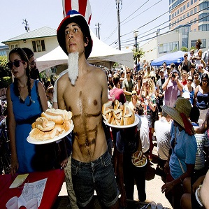
Hot Dog

Slide 5
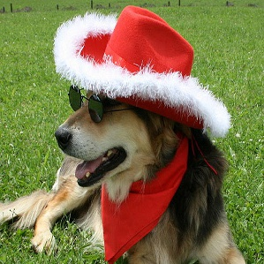
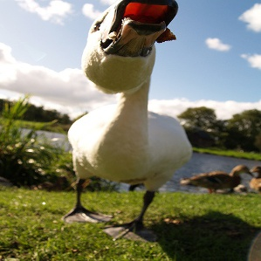
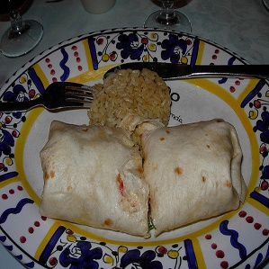
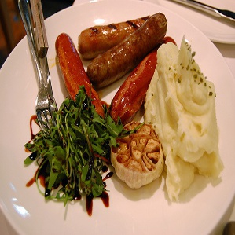
Not Hot Dog

Slide 6
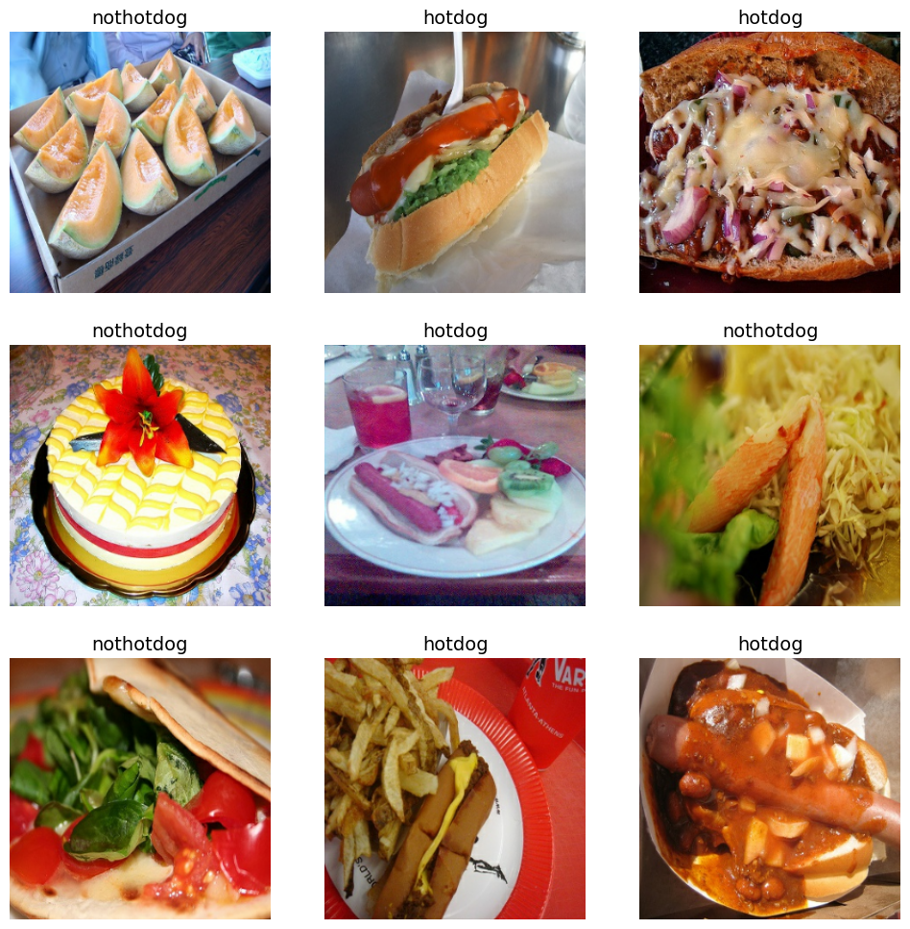
Pre-Processing!
Load data using a Keras utility
Use 80% of the images for training and 20% for validation
Visualize the data
Standardize RGB data
Configure the dataset for performance

Slide 7
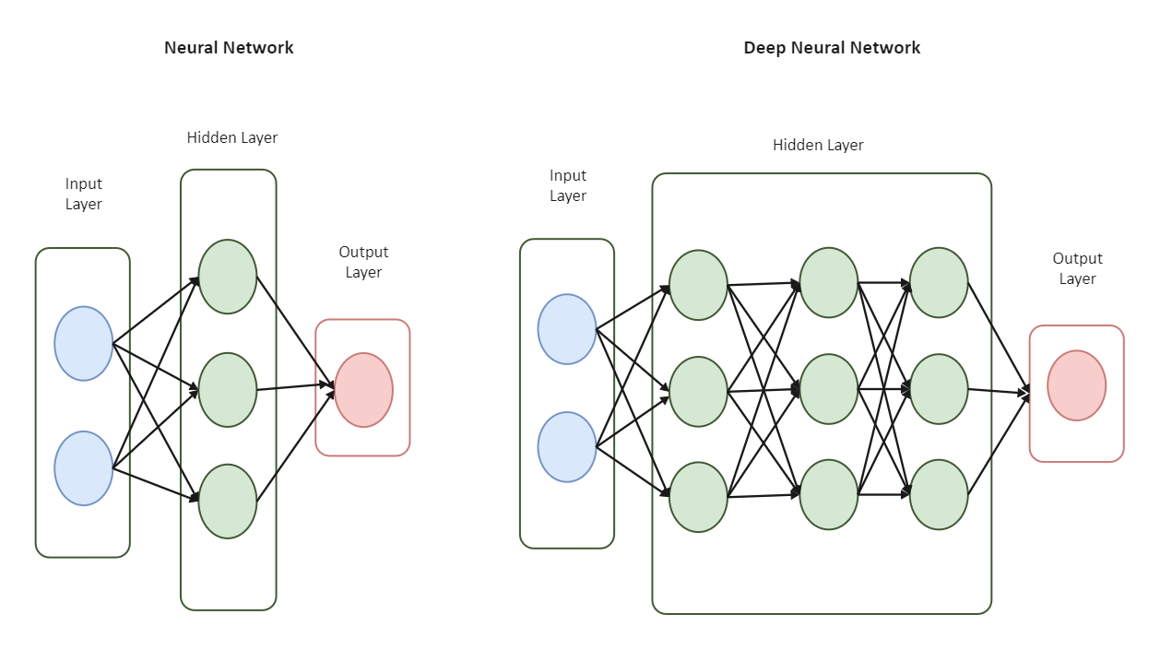
Neural Net Model
Create 2D convolution layers (Relu activation), w/ max pooling operation
Flatten into a single dimension
Output layer Sigmoid for classification
Compile model with Adam optimizer
Fit model with 20 epochs
Notes:
Lisa

Slide 8
Winning Model
Baseline Accuracy | Model Accuracy
0.50 | 0.95

Slide 9
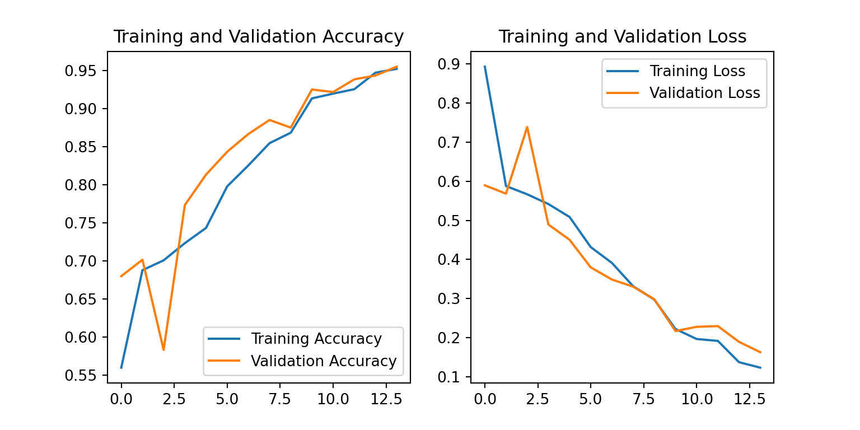
Winning Model

Slide 10
Other Model Options
Deep Learning frameworks: Tensorflow and Keras
ResNet50→Val:0.9433, Test: 0.9477
AlexNet → Val:0.5100, Test: 0.6531
VGG-19 → Val: 0.9183, Test: 0.9225
Notes:
ResNet-50: ResNet50 is a specific variant of ResNet that contains 50 convolutional layers. It has been widely used for image classification tasks and is known for its superior performance.
AlexNet: AlexNet consists of five convolutional layers, three fully connected layers, and the extensive use of rectified linear units (ReLUs) for non-linearity.
VGG: It is characterized by its simplicity, using 3x3 convolutional layers with a small filter size and deep networks. VGG architectures, such as VGG16 and VGG19, consist of 16 or 19 weight layers, respectively.

Slide 11
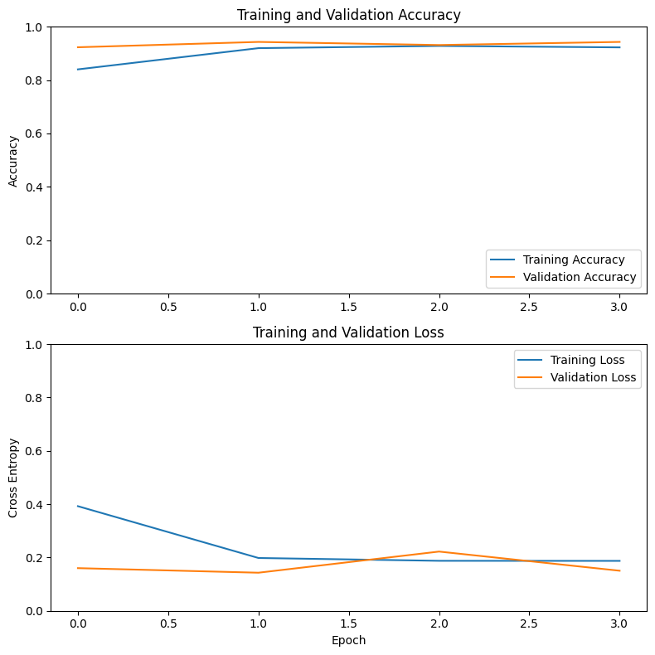
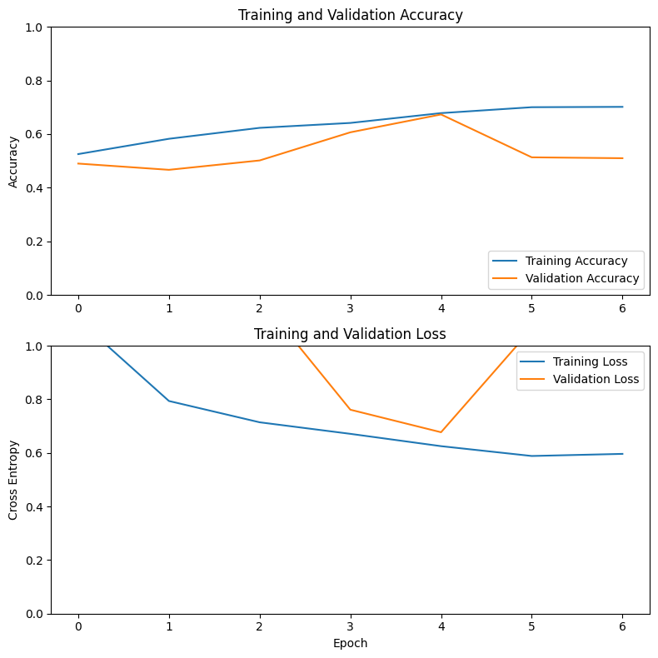
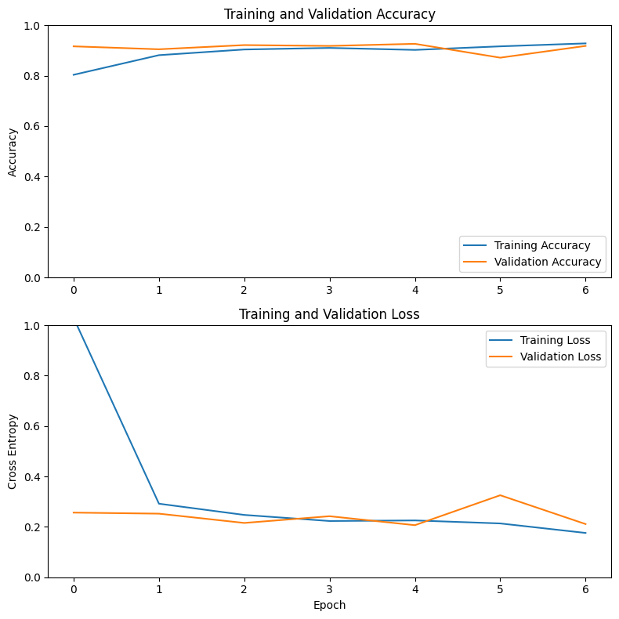
ResNet-50 AlexNet VGG-19

Slide 12
Streamlit App Debut

Slide 13
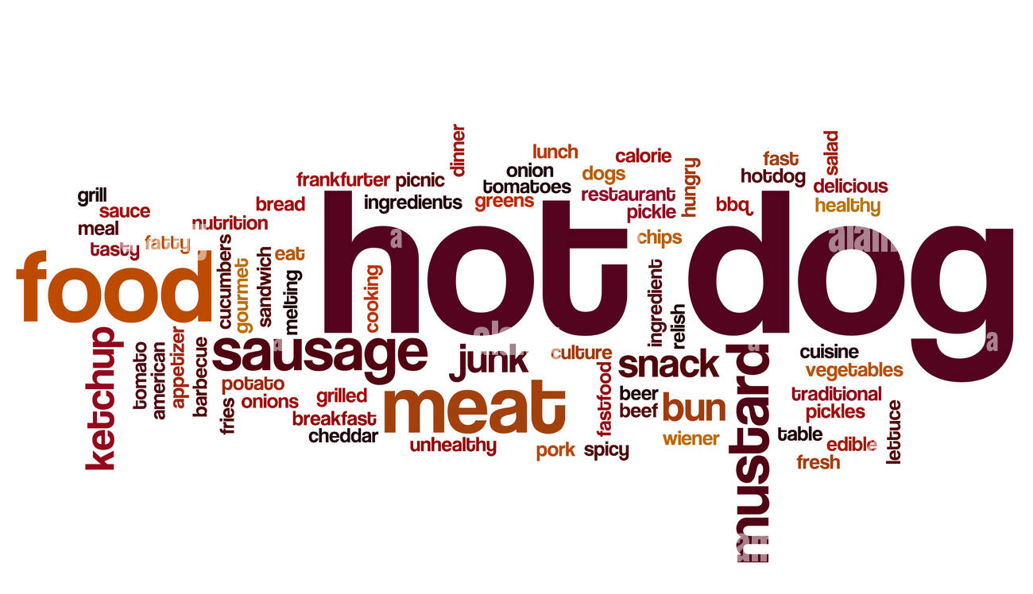

Slide 14
Thank You!!
Any Questions?

